Slide 1
Parenchymal Chamber for Biomimetic Liver Vascular Network
Building a Liver Assist Device
Arjun Bahl, Cameron Hinkel, and Ben Jiang – Group 28
Mentor: David Hoganson, MD

Slide 2
Overview
Need
Treatment of liver disease
Design
Biomimetic vascular network
Parenchymal cell chamber
Analysis
COMSOL model
Details
Specific parenchymal chamber design features

Slide 3
Need

Slide 4
Liver Disease
Need Design Analysis Details
Affects 25 million Americans
19 million cases involve viral hepatitis or cirrhosis
Major organ shortage
~7000 liver transplants each year
16,200 remain on waitlist
2000 will die this year waiting for a transplant

Slide 5
Addressing the Organ Shortage
Need Design Analysis Details
All tissue engineering approaches prior to 1998 were angiogenesis dependent
Obvious need for vascular scaffold
Langer R, Vacanti J. Tissue engineering. Science 1993;260:920-926

Slide 6
Design

Slide 7
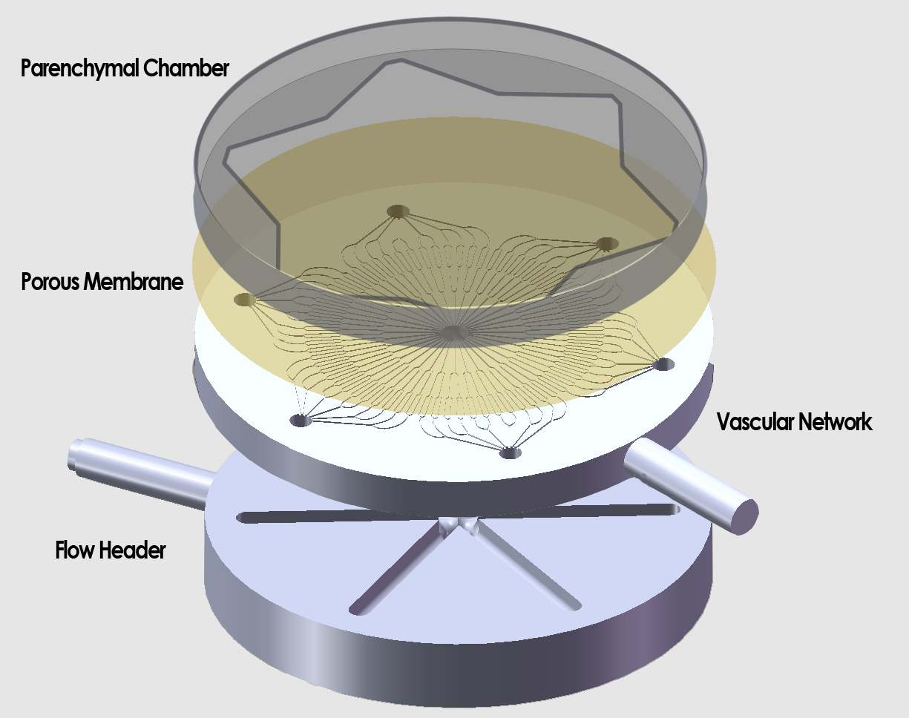
Design overview
Need Design Analysis Details

Slide 8
Design Choices: Chamber
Need Design Analysis Details
Chamber height
Transport of nutrients, waste
Surface geometry
Surface area optimization
Surface coating
Hepatocyte affinity to PDMS, collagen

Slide 9
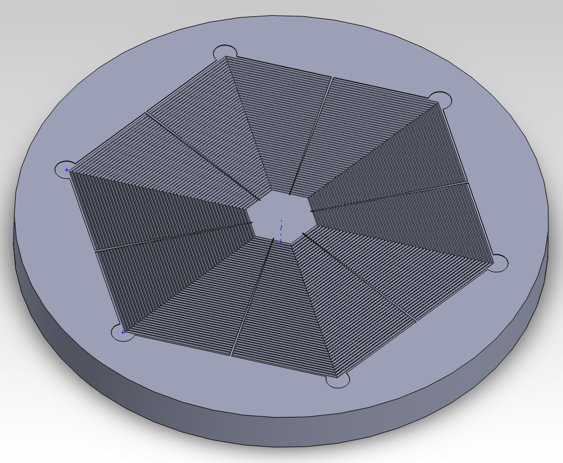
Circumferential Orientation
Need Design Analysis Details
64 micron deep triangular features
Surface area increased by 41%

Slide 10
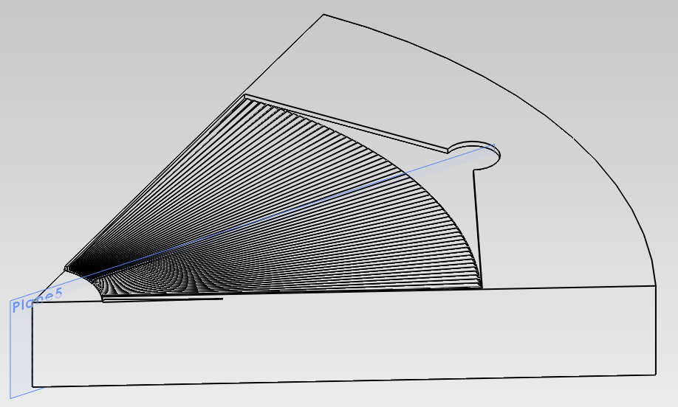
Radial Orientation
Need Design Analysis Details
64 micron deep triangular features at outer edge
Features converge toward center
Surface area increase is less than 41%

Slide 11
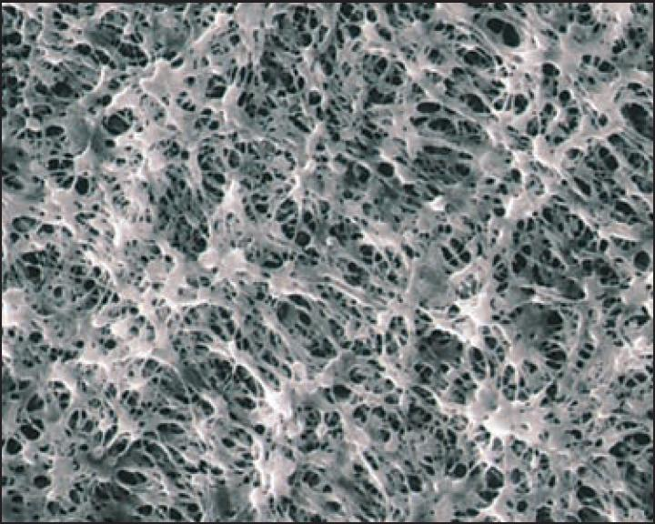
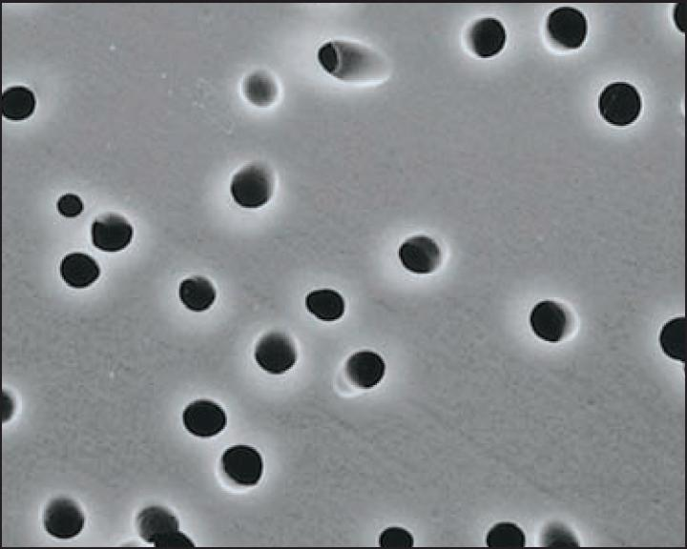
Design Choices: Membrane
Need Design Analysis Details
Material
Polycarbonate, PTFE
Thickness
Pore size
Porosity
Membrane | Permeability [m²/(Pa·s)]
0.4μm PC | 2.98E-08
1.0μm PC | 3.14E-07
3.0μm PC | 1.06E-06
1.0μm PTFE | 1.76E-07

Slide 12
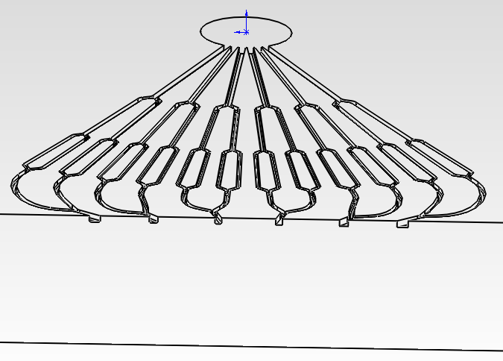
Section Views (Liver Network)
Need Design Analysis Details

Slide 13
COMSOL Model
Need Design Analysis Details
Three domains
Convective fluid flow
Species transport: Diffusion and convection
Glucose, Albumin

Slide 14
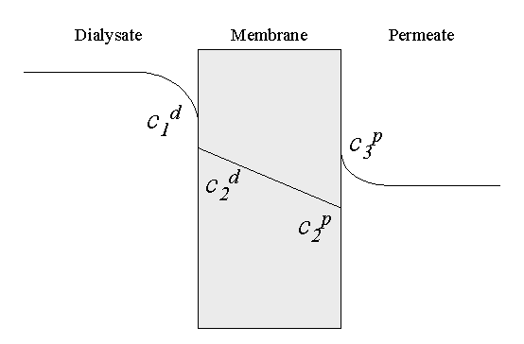
Equations
Need Design Analysis Details
Darcy’s Law
v = K ΔP
Flux of dissolved species
Q = Q_{c} + Q_{d}
Q_{c} = v·C
Q_{d} = M(K·C₁-C₂)
Cell activity
Glucose uptake proportional to local concentration
Constant albumin secretion

Slide 15
Analysis

Slide 16
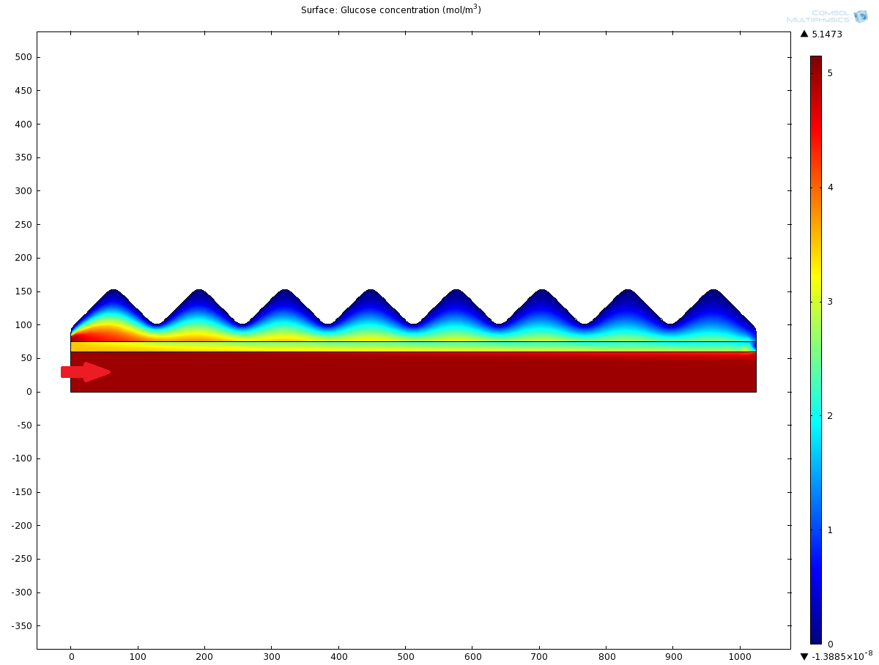
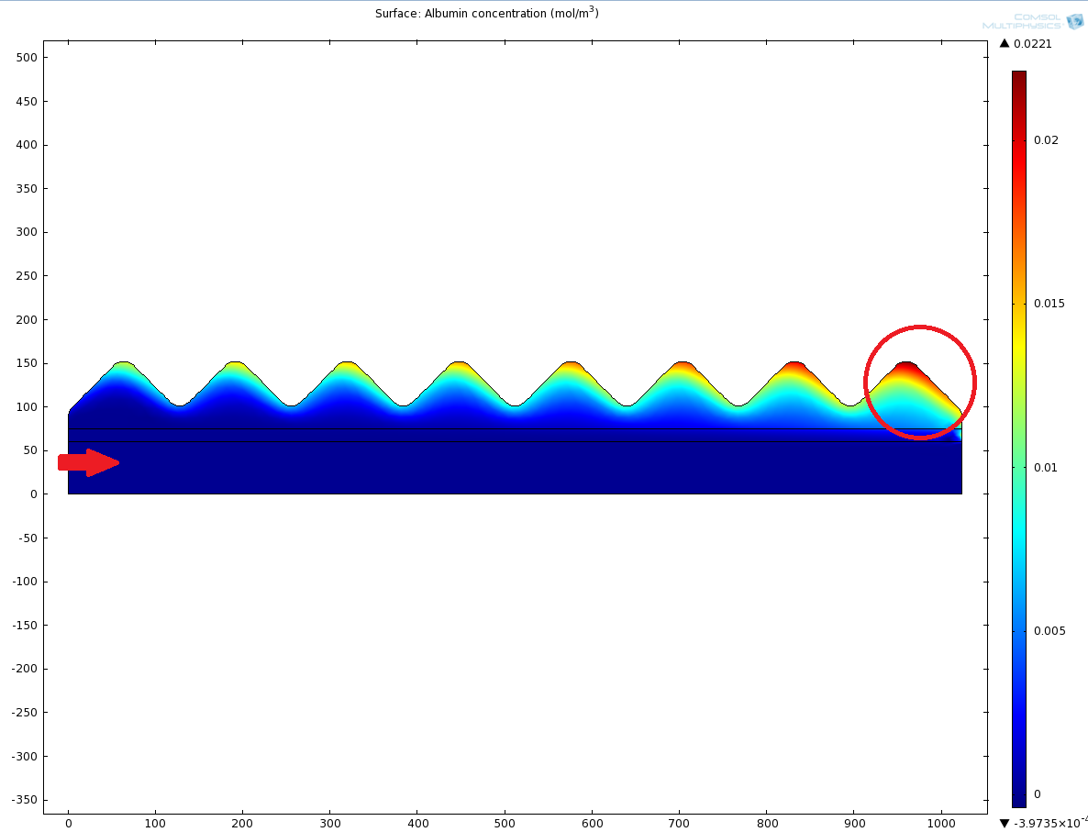
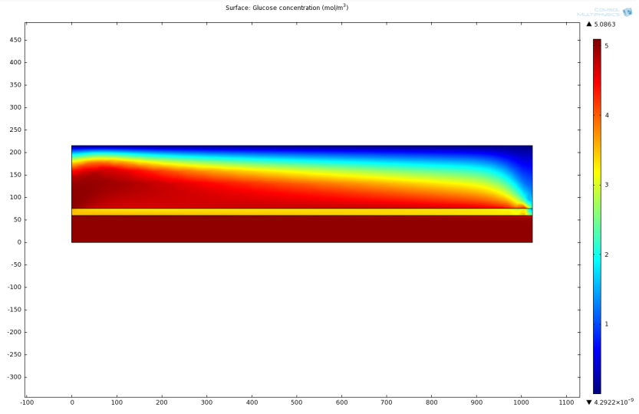
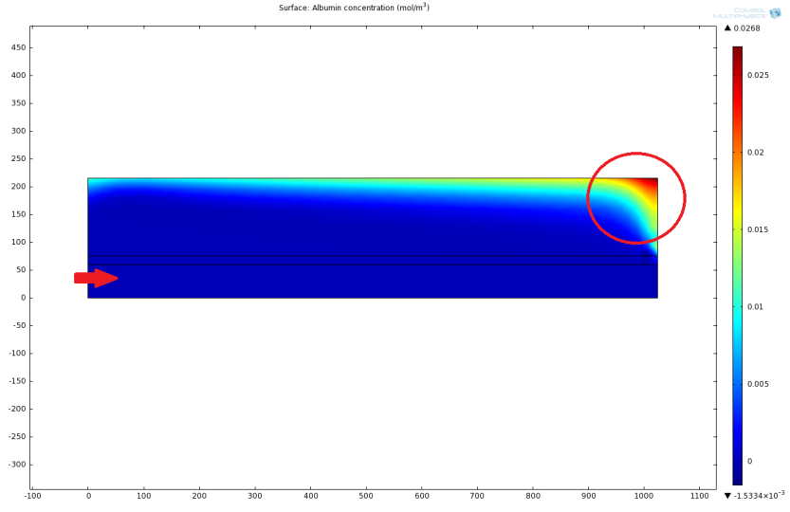
Computational Analysis
Need Design Analysis Details

Slide 17
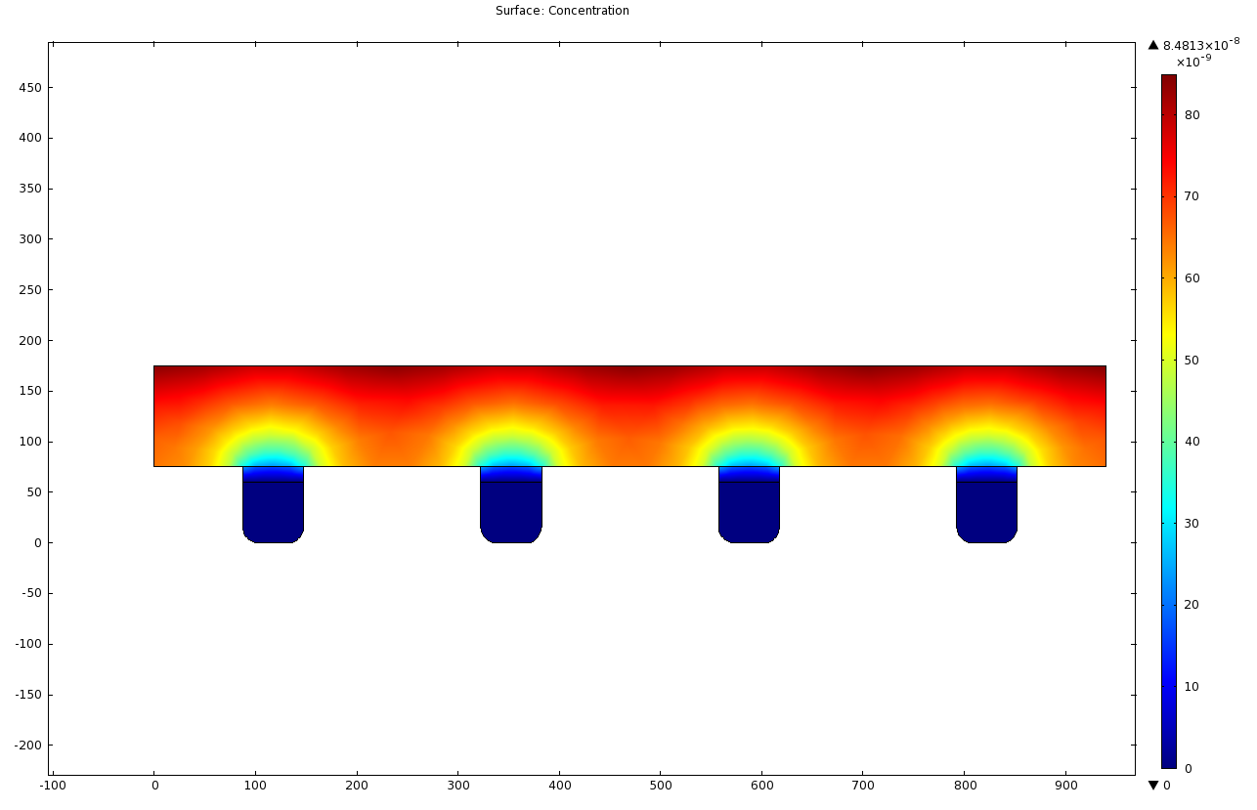
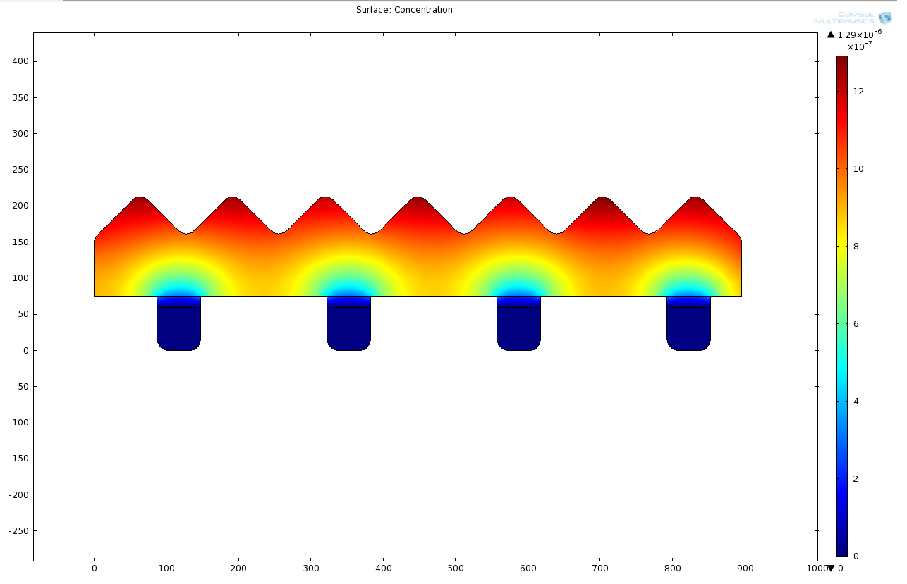
Computational Analysis
Need Design Analysis Details

Slide 18
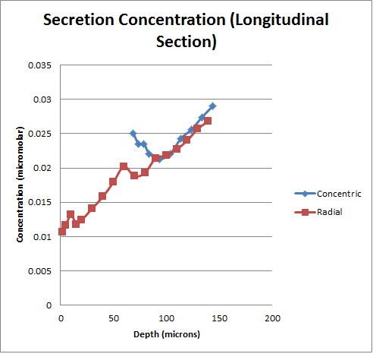
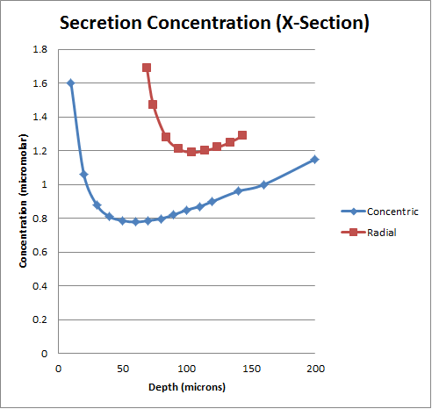
Computational Analysis
Need Design Analysis Details

Slide 19
Results
Need Design Analysis Details
Steady state operation
Triangular features increase surface area without impeding convection or diffusion
Sufficient glucose transport and albumin clearance occurs at most geometries
Optimal chamber depth
36 μm to 100 μm

Slide 20
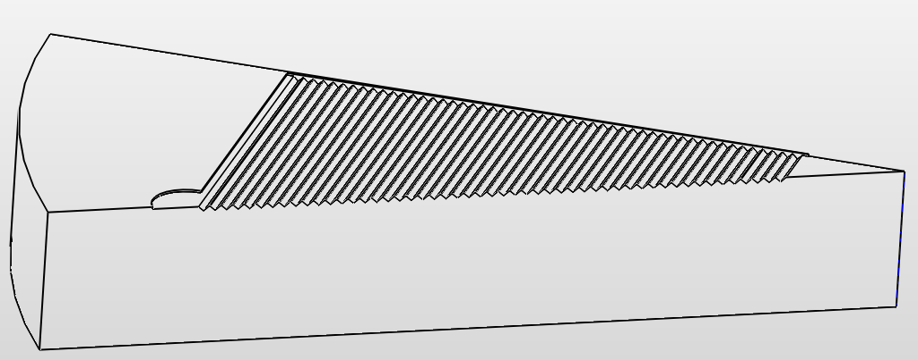
Design Summary
Need Design Analysis Details
Membrane
3µm Polycarbonate membrane
Maximal permeability
Chamber
45° concentric triangular features
36µm to 100µm depth

Slide 21
Responsibilities
Need Design Analysis Details
Arjun
Mathematical concepts
Analyzing computational model results
Final Presentation
Cameron
Primary communications with David Hoganson
Steering design considerations
CAD drawings
Ben
Experimental design
Simulation parameters
COMSOL

Slide 22
Schedule
Need Design Analysis Details
Oct 26 Complete Progress Report
Nov 3 Expand to 3D Model
Nov 9 Refine Chamber Geometry
Nov 16 Run Extensive Simulations
Nov 29 Complete Design with all Modifications
Dec 2 Acquire total cost
Dec 7 Deliver final report

