Slide 1
Parenchymal Chamber for Biomimetic Liver Vascular Network
Building a Liver Assist Device
Arjun Bahl, Cameron Hinkel, and Ben Jiang – Group 28
Mentor: David Hoganson, MD

Slide 2
Overview
Need
Discussion of liver disease and need for artificial organ solution
Technology
Biomimetic vascular network design
Scope
Design Requirements
Specific parenchymal chamber design features

Slide 3
Need

Slide 4
Liver Disease
Need Technology Scope Design Requirements
Affects 25 million Americans
19 million cases involve viral hepatitis or cirrhosis
Major organ shortage
~7000 liver transplants each year
16,200 remain on waitlist
2000 will die this year waiting for a transplant

Slide 5
Addressing the Organ Shortage
Need Technology Scope Design Requirements
All tissue engineering approaches prior to 1998 were angiogenesis dependent
Obvious need for vascular scaffold
Langer R, Vacanti J. Tissue engineering. Science 1993;260:920-926

Slide 6
A System in Clinical Trials
Need Technology Scope Design Requirements
http://www.vitaltherapies.com/elad_assests/elad_simulation.html
ELAD (Extracorporeal Liver Assist Device) system supports most native liver functions
Challenges:
Large, extracorporeal system
Requires extensive use of anticoagulants
Must be used in intensive care setting
Does not account for all liver functionalities

Slide 7
Technology

Slide 8
Geometrically Complex Organ
Need Technology Scope Design Requirements
Highly branched, complex 3-dimensional structure
Components:
Hepatic Sinusoids
Bile Ducts
Hepatocytes
Biliary Cells
Kupffer Cells
Etc.
http://www.ener-chi.com/liver.htm

Slide 9
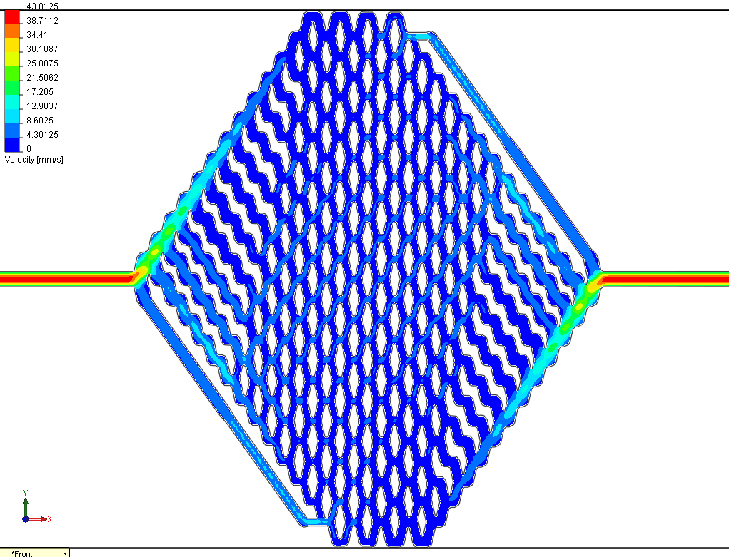
Vascular Network Design
Need Technology Scope Design Requirements
Vascular network design concepts developed in the laboratory of Joseph P. Vacanti, MD – Department for Surgery, Center for Regenerative Medicine, Massachusetts General Hospital
Test-Net One
Test-Net Alpha

Slide 10
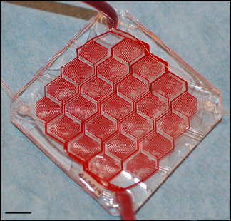
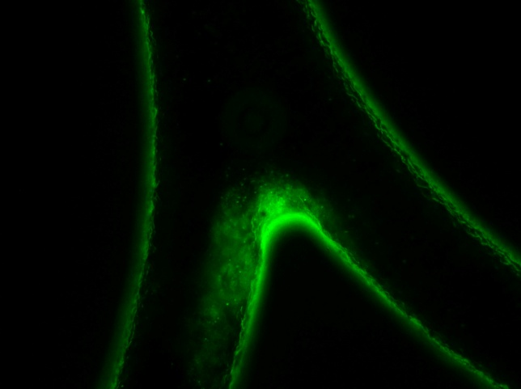
Clot Formation
Need Technology Scope Design Requirements
Development of a hemodynamically compatible design
Version 1
Version 2

Slide 11
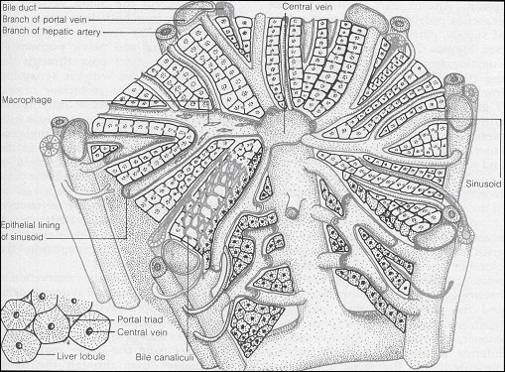
Biomimetic Design
Need Technology Scope Design Requirements
~6mmHg Pressure Differential
Physiologically Normal Shear Stress

Slide 12
Cell Viability
Need Technology Scope Design Requirements

Slide 13
Scope

Slide 14
Parenchymal Chamber Design
Need Technology Scope Design Requirements
Coupled semi-permeable membrane and cell chamber
Variable Parameters:
Chamber depth
Chamber shape
Flow-control features
Membrane pore size
Membrane porosity
Static vs. dynamic pressure
Carraro (needs citation)

Slide 15
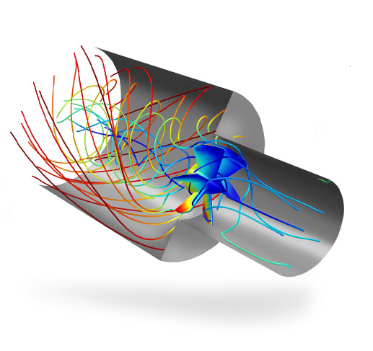
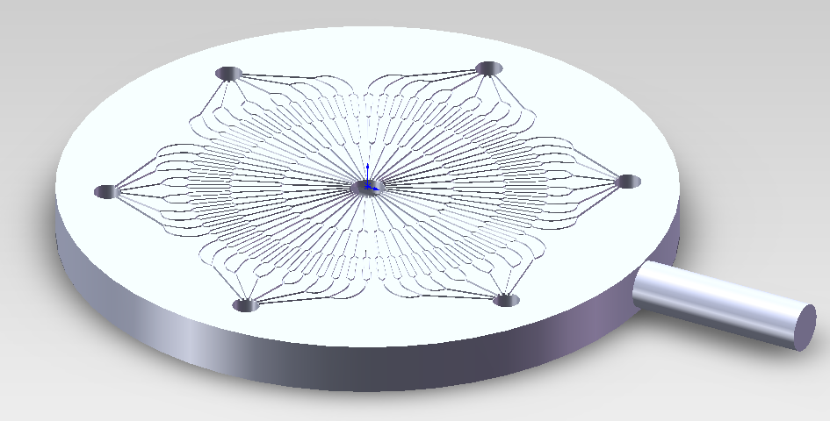
CAD and CFD
Need Technology Scope Design Requirements
SolidWorks
COMSOL Multiphysics
http://www.comsol.com/products/cfd/

Slide 16
Design Requirements

Slide 17
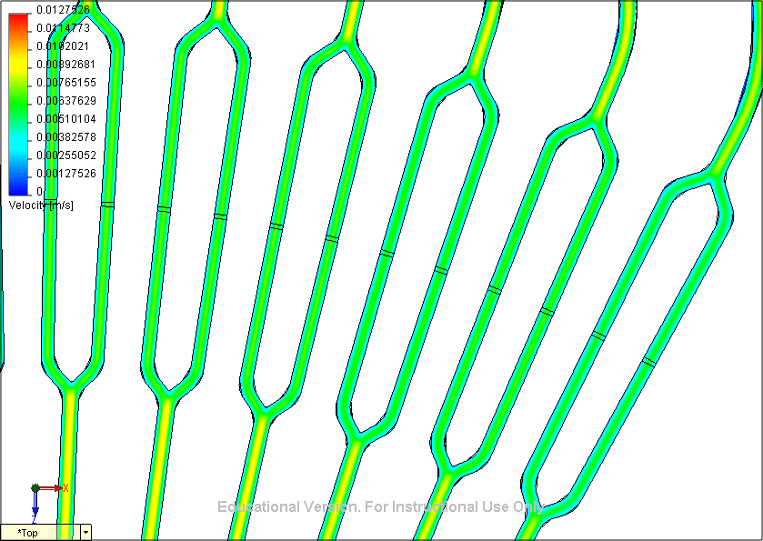
Mathematics
Need Technology Scope Design Requirements
Non-Newtonian Fluid Model
Navier-Stokes Equation with constant velocity term
Reynold’s Number
Re = ρvL / μ
Poiseuille’s Equation
Q = 4πr(P1-P2)
8μL
Conservation of Mass
Conservation of Momentum
Ohm’s Law
V = IR

Slide 18
Metrics and Parameters
Need Technology Scope Design Requirements
Membrane
Pores must be smaller than 1 micron
Porosity affects chamber flow
Size
10:1 initial scale
Scalable Design
Minimal Volume
~2mm thick
~100 microns deep
Flow
Flow through whole device is pre-determined by pressure profile of vascular network (6mmHg drop from inlet to outlet)
Goal – Develop a flow-field within the chamber
Particle exchange

Slide 19
Future Considerations
Need Technology Scope Design Requirements
Model
Matches vascular network
Scalable
Design compatibility with various media
Silicone
Biological scaffold
Cell growth surface considerations
Must not grow on membrane
Possible features to increase surface area

Slide 20
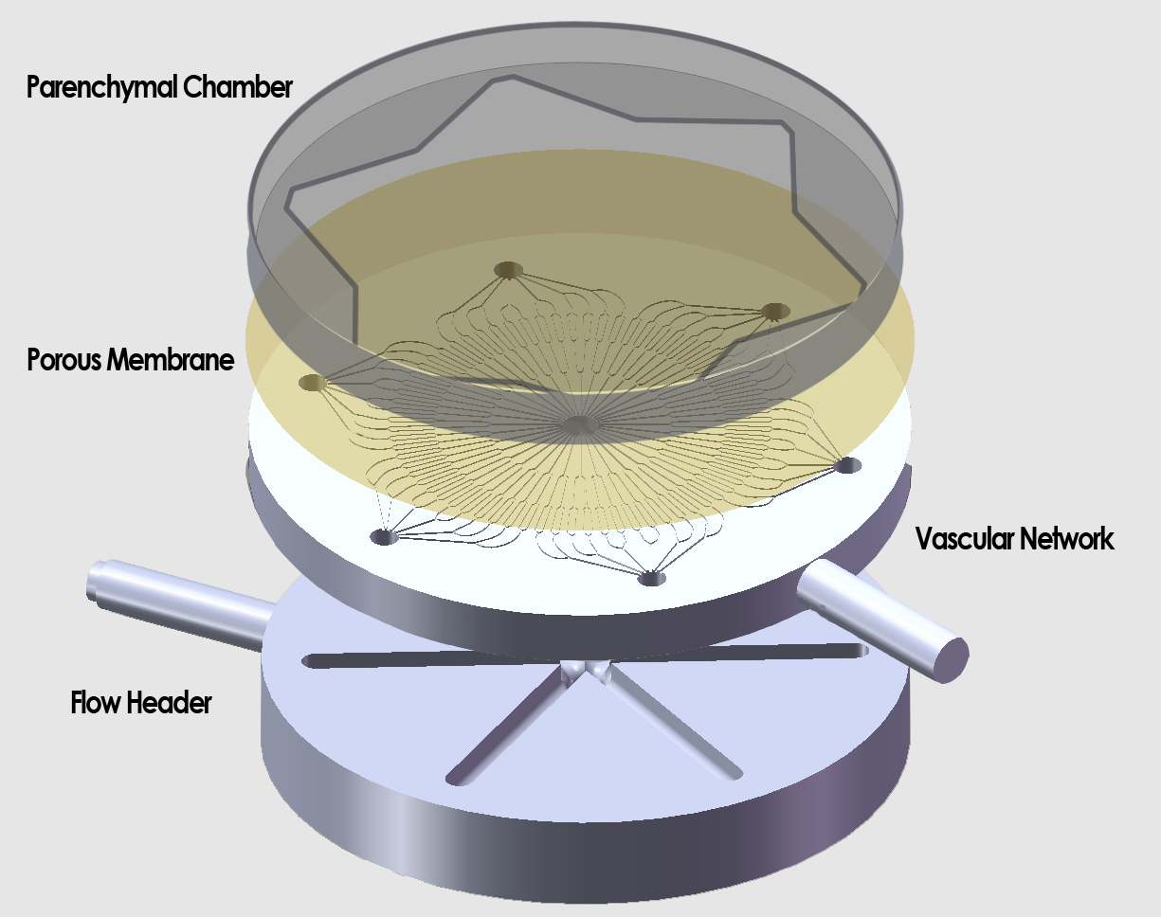
Concept
Need Technology Scope Design Requirements

Slide 21
Responsibilities
Need Technology Scope Design Requirements
Arjun
Mathematical concepts
Analyzing computational model results
Progress presentation
Cameron
Primary communications with David Hoganson
Steering design considerations
CAD drawings
Ben
Experimental design
Simulation parameters
Final presentation

Slide 22
Tentative Schedule
Need Technology Scope Design Requirements
Oct 3 Meet with Dr. Venkat Subramanian about the use of COMSOL
Oct 5 Design basic chamber model
Oct 7 Run computational simulations to establish chamber flow profile for different membrane materials
Oct 12 Finalize membrane properties
Oct 14 Begin simulating flow with different chamber design paradigms
Oct 21 Finalize chamber design paradigm
Oct 26 Deliver progress report
Oct 28 Begin optimizing and improving chamber design in detail
Nov 14 Run extensive simulations to fully understand fluid and solvent transport for chosen design
Dec 7 Deliver final report

Slide 23
References
Need Technology Scope Design Requirements
Burns, Owen, Biomimetic Design of a Liver Specific Vascular Network, University of Wollongong Department of Engineering, Senior Thesis, 2008
Carraro, Amadeo, et. al., In vitro analysis of a hepatic device with intrinsic microvascular-based channels, Biomed Microdevices, 2008
Griffith, L.G., Acta Mater, pp. 48, 263, (2000)
Hoganson, David M., et. al., Tissue Engineering and Organ Structure: A Vascularized Approach to Liver and Lung, Pediatric Research, 2008
Hoganson, David M., et. al., Principles of Biomimetic Vascular network Design Applied to a Tissue-Engineered Liver Scaffold, Tissue Engineering, Vol. 16, No. 5, 2010
Hoganson, David, various presentations
Hsu, Wen-Ming, et. al., Liver-Assist Device With a Microfluidics-Based Vascular Bed in an Animal Model, Annals of Surgery, 2010
Kaihara, Satoshi, et. al., Silicon Micromachining to Tissue Engineer Branching Vascular Channels for Liver Fabrication, Tissue Engineering, Vol. 6 No. 2, 2000

Slide 24
Parenchymal Chamber for Biomimetic Liver Vascular Network
Building an Artificial Liver
Arjun Bahl, Cameron Hinkel, and Ben Jiang – Group 28
Mentor: David Hoganson, MD

