Slide 1
Parenchymal Chamber for Liver Assist Device
December 5, 2011
Arjun Bahl, Ben Jiang, Cameron Hinkel
Group 28

Slide 2
Part I: Need, Design Concept and Requirements

Slide 3
Liver Disease
Affects 25 million Americans
19 million cases involve viral hepatitis or cirrhosis
Major organ shortage
~7000 liver transplants each year
16,200 remain on waitlist
2000 will die this year waiting for a transplant

Slide 4
Concept
An external hepatic liver device connected at the inlet to the Hepatic Portal Vein and at the outlet to the Inferior Vena Cava, such that it functions in parallel to the liver.
Consisting of a large number of subunits that each mimic natural blood flow in the capillary system of a liver lobule
A biomimetic vascular network has already been created

Slide 5
Concept
Each subunit would consist of (1) an inlet, (2) parenchymal chamber,(3) membrane, (4) vascular network, and (5) outlet.
The scope of this project is the design of the parenchymal chamber.
The subunits are connected by a flow-header system.

Slide 6
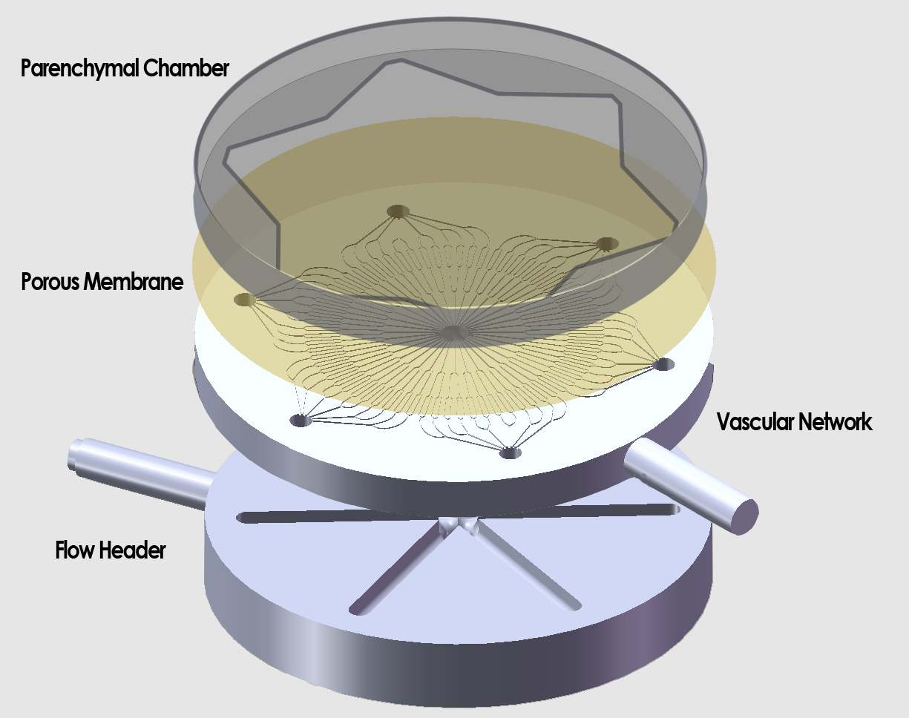

Slide 7
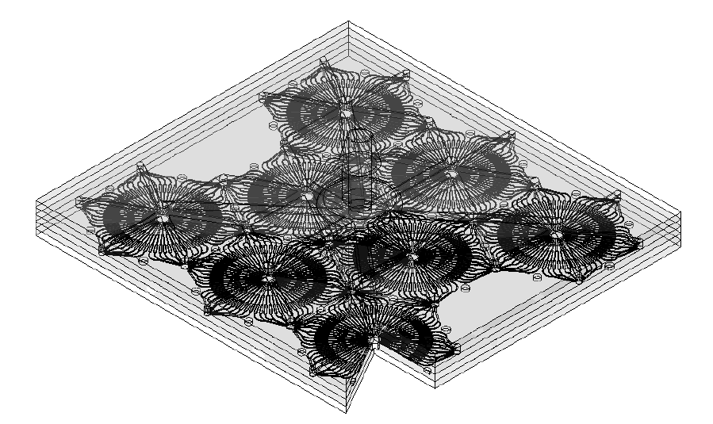

Slide 8
Design Requirements
Must provide 1% liver function
Assume function proportional to number of cells
Would match current State-of-Art
Can keep a patient alive for approximately 2 weeks while waiting for transplant
Membrane pore size < 3 microns
To prevent hepatic cell permeation through membrane
FDA implications
Low total volume
State-of-the art Liver Assist Device is a large bedside system taking up most of the room space, developed by Vital Therapies ©
Should theoretically be scalable to > 1% liver function

Slide 9
Design Requirements
Chamber requirements
Adequate waste washout
Normal Blood albumin concentration is 34-54 g/L
Interstitial concentration is 10%-20%
Current Problem: Cell death due to Pressure Buildup – A failed device by another group grew cells on the bottom of the membrane. Growing the cells on the top is our solution, which we have not discussed in previous reports for IP concerns.
To optimize volume and achieve 1% percent liver function, maximize viable surface area per subunit

Slide 10
Part 2: Design Analytics

Slide 11
Maximizing Capacity
Liver contains 210 billion hepatocytes
Surface area of a hepatocyte: $\sim 260μm^{2}$
A flat parenchymal chamber would fit ~1 million cells/subunit
2100 units base case

Slide 12
Maximizing Capacity –Geometries
Shape | % Increase | Effective Increase (45* cutoff)
Square | 100% | 0%
Half Circle | 57% | 29%
Sinusoid | <41% | <41%
Quarter Circle | 11% | 11%
Trapezoid | 28% | 28%
Triangle | 41% | 41%
Show a calculation

Slide 13
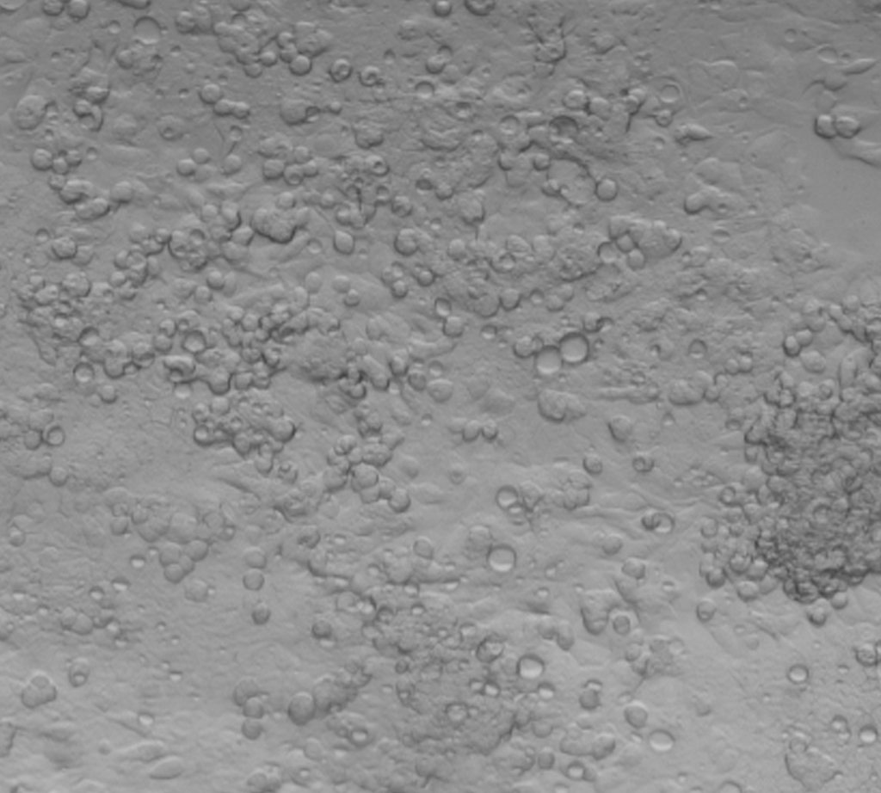
Viable Cell Growth on Vertical Surface
100x Magnification:
1 Day after Seeding 5 Days after Seeding

Slide 14
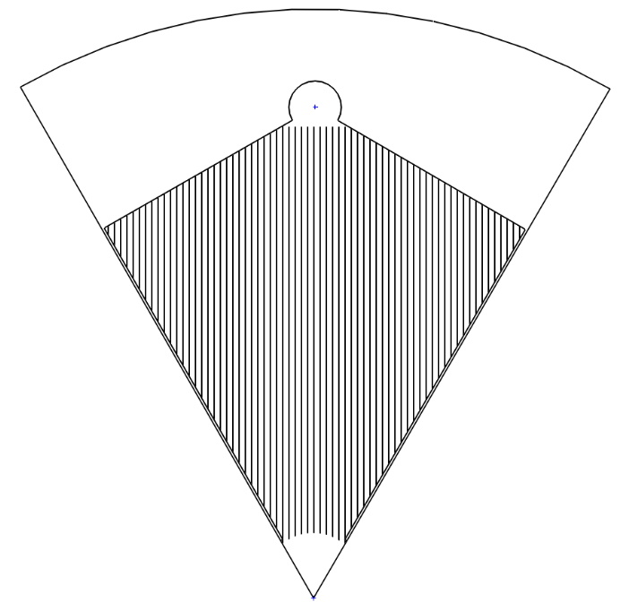
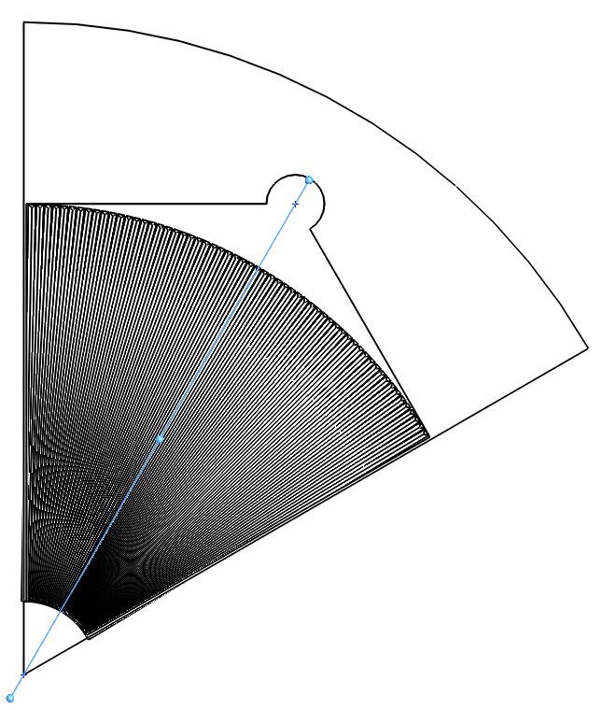
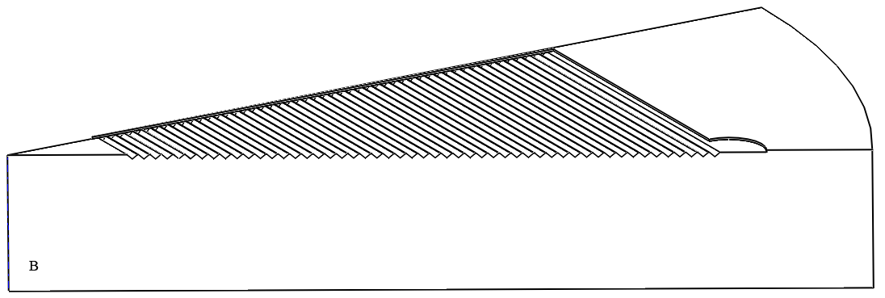
Feature Arrangement
Parallel
Radial
Concentric

Slide 15
COMSOL Model Parameters
Membrane Permeability
Darcy’s Law
Albumin Boundary Condition
Secretion rate in volume/surface area
Glucose Boundary Condition
Consumption rate in volume/surface area
Albumin and Glucose Diffusion Constants

Slide 16
COMSOL Model Parameters – Membrane Permeability
Darcy’s Law: u = KΔP
Membrane | Permeability
 | (m/s*Pa)
PTFE 1um | 1.76E-07
Polycarbonate 0.4 um | 2.98E-08
Polycarbonate 1um | 3.14E-07
Polycarbonate 3um | 1.06E-06

Slide 17
COMSOL Model Parameters – Albumin Secretion
Albumin secretion, rats: 2.14 mg/100 g/ hour
Hepatocytes 20uM diameter
Hepatocyte 70-80% of cytoplasmic mass of liver
Albumin mass: 67kDa
Albumin secretion: 1.98*10^-12 mol/(m^2*s)

Slide 18
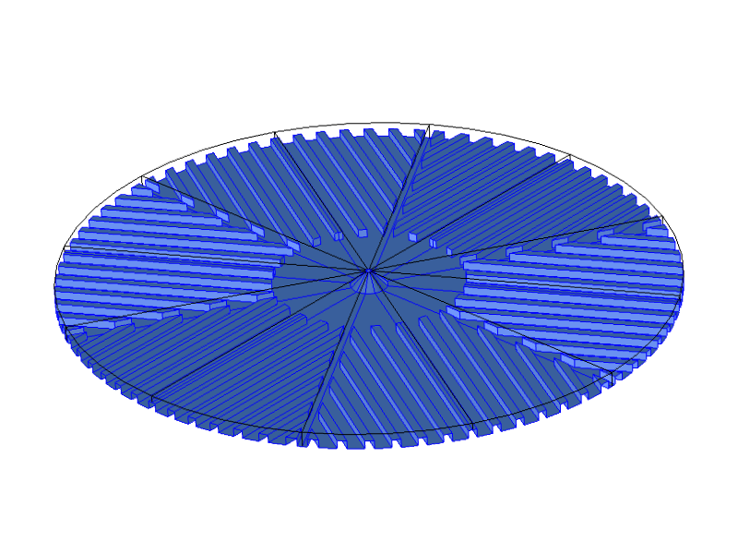

Slide 19
COMSOL Model Parameters – Other
Albumin Diffusion
2*10^-8 m^2/s
Glucose Consumption
1.6 pmol/min*μg protein
1.38 mol/cm^2
Glucose Diffusion
8*10^-8 m^2/s

Slide 20
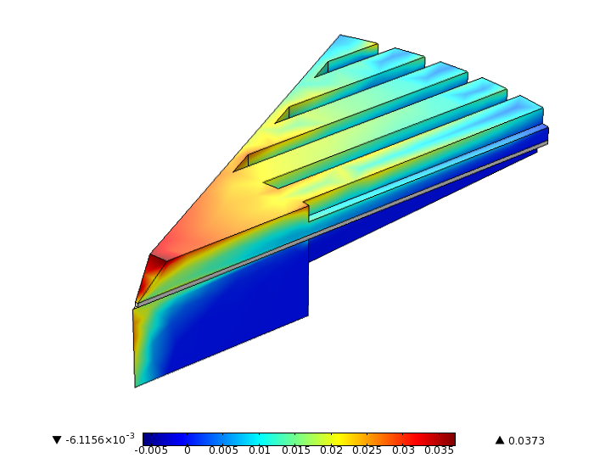
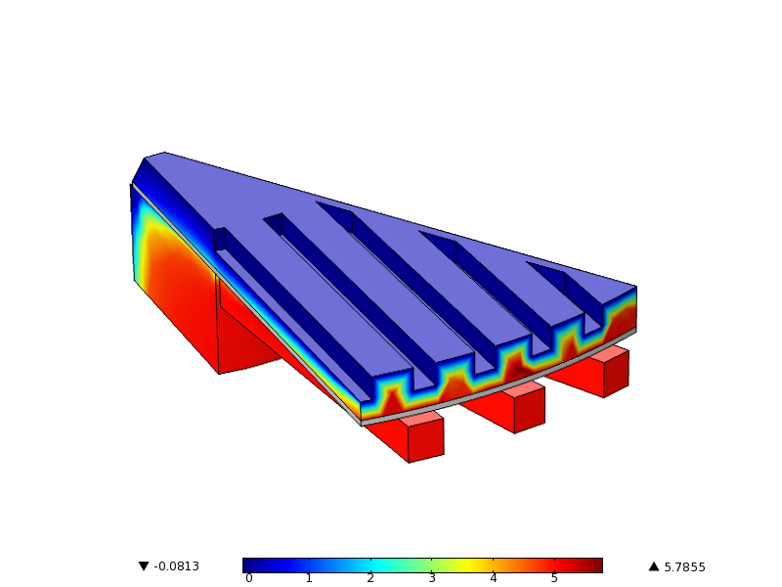
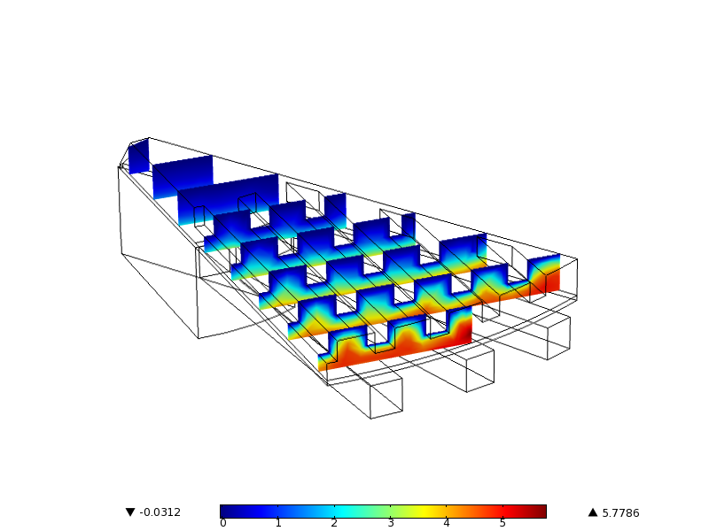
Summary of Results
Albumin removal
Glucose consumption

Slide 21
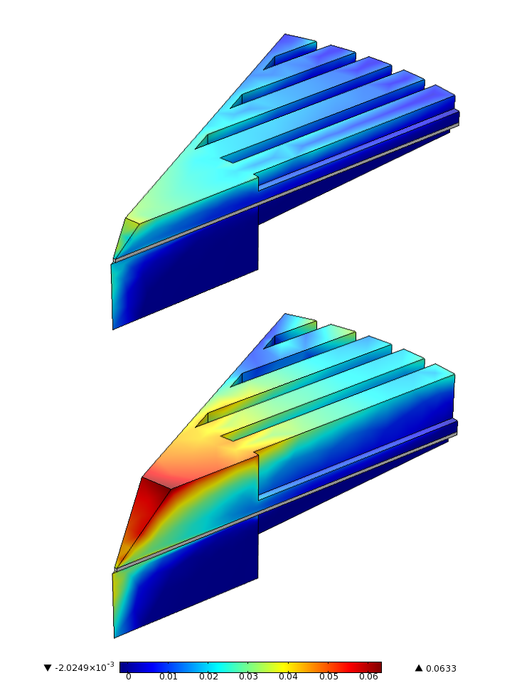
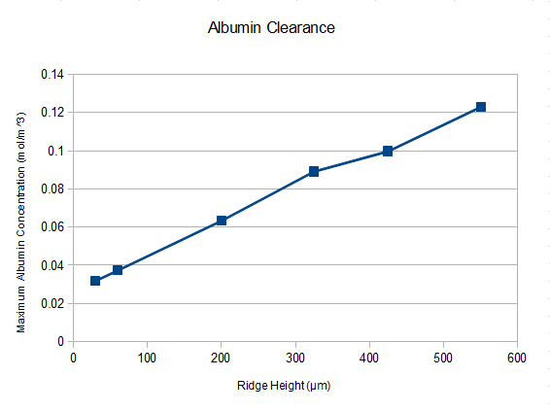
Ridge Height
Based on physiological albumin levels found in literature, we decided to use a ridge height of 200 μm.

Slide 22
Part 3: Design Details

Slide 23
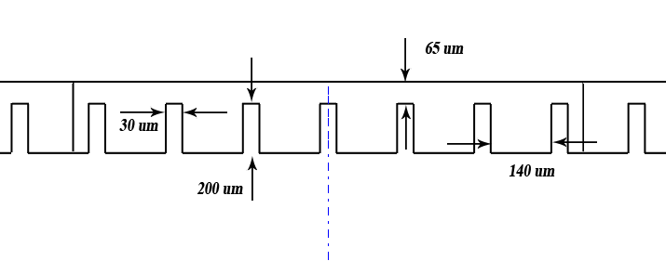
Ridge Dimensions
65 uM – large enough for proper seeding without increasing volume
200 uM – determined by albumin buildup

Slide 24
Results
New surface area: 570 uM
Base case surface area: 170 uM
> 3 fold increase in viable surface area
Requires 626 units assuming maximum efficiency

Slide 25
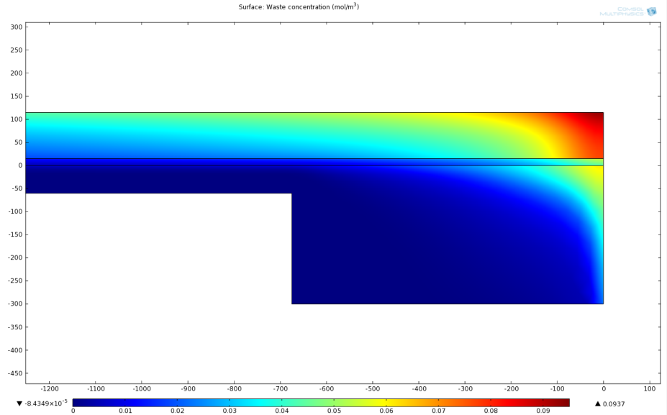
Cone Outlet

Slide 26
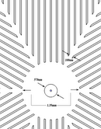
Other Dimensions
100uM
570uM
1.35mm

Slide 27
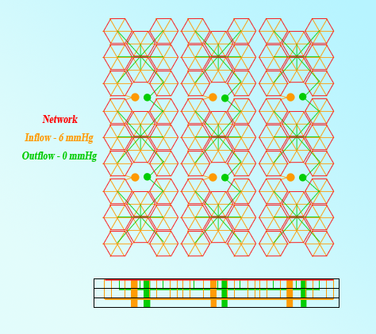
Other Dimensions
Layer thickness: 5 mm
~14mm x 15 mm
Requires 9 layers assuming maximum efficiency: < 2L

Slide 28
Part 4: Materials and Manufacturing

Slide 29
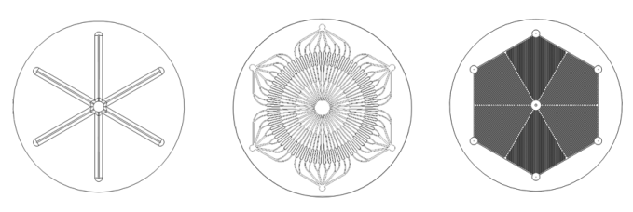
Subunit Assembly
Assembly of a single unit of the liver assist device begins with a 10:1 mixture of PDMS polymer to curing agent. This liquid PDMS is poured into each of 3 molds
Parenchymal Chamber mold depth: 0.5 mm
Vascular Network and Flow Header require placement of silicon tubing before mold is pored.

Slide 30
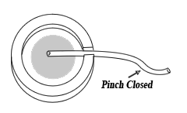
Subunit Assembly
Molds are allowed to de-gas for 24 hours before being placed into an 85ºC incubator for 1-1.5 hours to cure the PDMS

Slide 31
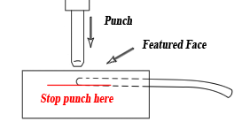
Subunit Assembly
A 1mm hole is punched at the center of the vascular network and the flow header. The hole is punched from the featured face of the PDMS mold and goes through the top side of the silicone tube. The punch should not pass through the bottom side of the silicone tube or the rest of the PDMS.

Slide 32
Subunit Assembly
A thin collagen film (Rat Tail, Type I) is applied to the roof of the chamber according to a complex, unpublished method developed in David Hoganson’s laboratory.

Slide 33
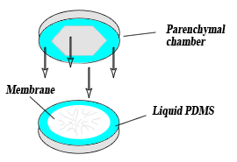
Subunit Assembly
An extremely thin layer of liquid PDMS (about 10 microns) is stamped onto the featured faces of the flow header, vascular network, and parenchymal chamber. A piece of PCTE filter is carefully placed on the wet network face and the chamber is placed over the membrane. The flow header is glued in place beneath the vascular network layer. This assembly is placed in an 85ºC incubator for 2 hours. A 0.5kg steel weight is placed on top of the assembly to insure a tight bond.

Slide 34
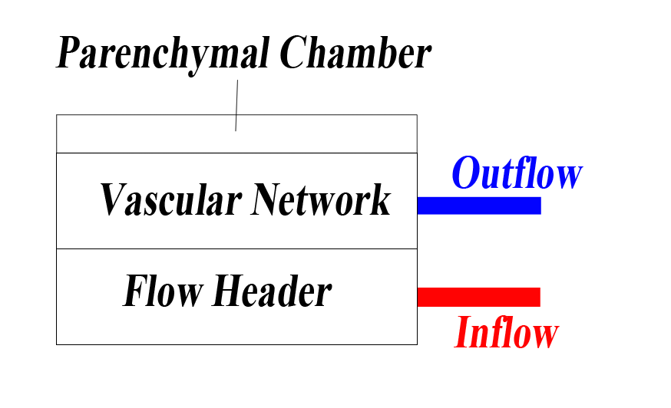
Subunit Assembly
The inlet and outlet tubes are immediately attached to a pressurized perfusive media system with a 6 mmHg pressure drop provided across the network.

Slide 35
Cell Seeding
Cell seeding is achieved through an inlet and outlet channel cut into the parenchymal chamber from the sides. Because of the complex surface geometry, the chamber must be seeded twice, once at a 45º angle relative to level and a second time at -45º relative to level. This ensures that hepatocytes adhere to the vertical faces of the chamber, hastening their growth to confluency over the entire surface area of the chamber. A solution of DMEM (Dulbecco’s Modified Eagle Medium) containing hepatocytes is flowed into the chamber. The concentration of cells is such that the seeding density is 100,000 cells/cm2. After seeding the inlet and outlet cuts are plugged up.

Slide 36
Prices/Lead Times
PDMS
Dow Corning Sylgard® 184 Silicone Elastomer Kit (~$50 for 1.1 lb kit, 3-4 kits required)
Silicone Tubing
SILASTIC® Laboratory Tubing #508-003 (1.19mmOD, 0.64mmID) ($25/box)
PCTE Membrane
Sterlitech - 1 micron pore size, 20x25mm, 30 pack ($330)
Molds
Contract micro milling with Draper Laboratory
$2500 for vascular network and parenchymal chamber
$1500 for inflow header, outflow header, and seeding header
Cells
C3A clonal derivative of HepG2 hepatocyte line – 1 vial from ATCC (American Type Culture Collection) ($280)
Total Lead time: 2-3 weeks

Slide 37
Multi-Unit Assembly
In general
3x3 Array of 8 subunits each
For >626 subunits, requires 9 layers
Involves
Additional Flow-Header level to maintain pressure across different stacks
Additional Seeding level to seed assembled stack
Beyond Scope

Slide 38
Part 5: Conclusions

Slide 39
IP
Novel idea of growing cells on roof of Parenchymal Chamber
Without it, cells release waste into the chamber itself and pressure buildup kills cells

Slide 40
Conclusions
Were we successful?
We do have a fairly sophisticated model that we believe is robust enough to merit a prototype. However, it could be made more accurate with a more in depth study of target molecules like Urea, Carbon Dioxide, and Oxygen.
Future Directions?
Increase quantity and sophistication of target molecule selection,
Create macroscopic model of flow header system to make sure pressure remains fairly consistent across subunits
What did we learn?
COMSOL, SolidWorks, CAD, Microfluidics, Engineering Design
What would we do differently?
Work on a cloud to run simulations faster
For references, see accompanying paper

